Slide 1
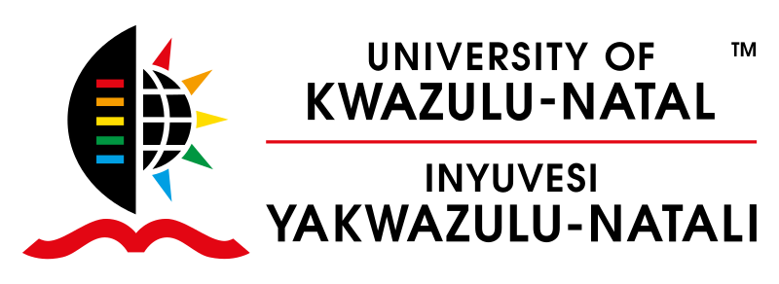



Climate Change, Food systems and Remote Sensing
Remote Sensing: Terms and Concepts
Facilitators
Dr. Trylee Nyasha Matongera (UKZN)
Dr. Mthembeni Mngadi (UKZN)

Slide 2
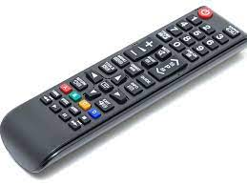
Understanding Remote Sensing
Remote - No contact between sensor and target!
Sensing 1) Sensor - There has to be a sensor – e.g. Camera
2) Energy -Sun or Energy from the sensor
NB: Electromagnetic Radiation
Line of sight - Clear line of sight between target and the sensor

Slide 3
Defining Remote Sensing
Remote Sensing (RS), also called Earth Observation (EO), is a science of obtaining/acquiring information about objects or areas at the Earth’s surface without being in direct contact with the object or area.
This is done by sensing and recording reflected or emitted energy and processing, analyzing, and applying that information."

Slide 4
Applications of Remote Sensing in:
Climate Change
Temperature Monitoring: Remote sensing helps monitor surface temperature changes, providing valuable data for studying regional and global temperature patterns.
Precipitation Monitoring: Remote sensing plays a crucial role in monitoring precipitation patterns and variations across the Earth's surface.
Vegetation Dynamics and Phenology: Remote sensing data helps monitor vegetation dynamics, including vegetation growth, phenological shifts, and changes in vegetation cover.

Slide 5
Applications of Remote Sensing in:
2. Global Health
Food security: Satellite imagery and aerial photography provide timely and frequent updates on crop conditions, allowing for early detection of stress factors (e.g., drought, pests, diseases) that can affect crop yield. #Precision Agriculture.
Disease Mapping and Surveillance: Remote sensing data can be used to map and monitor the spatial distribution of vector-borne diseases, such as malaria, dengue fever, and Lyme disease.
Disaster Management and Response: Satellite imagery enables rapid assessment of affected areas, identification of damaged infrastructure, and estimation of population displacement.

Slide 6
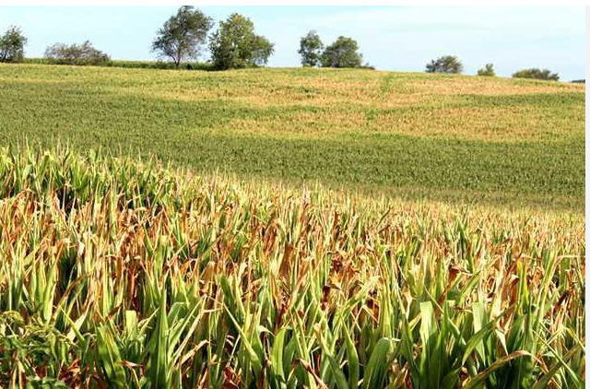
Crop Variability

Slide 7
The History of Remote Sensing
The History of Remote Sensing can be broadly classified under 3 periods:
The Early Age : 1839-1907
The Medieval Age : 1908- 1945
The Modern Age / Space Age : 1946 onwards

Slide 8
The Early Age : 1839-1907

Slide 9
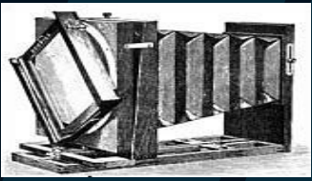
Invention of photography
The history of remote sensing began with the invention of photography. The term photography is derived from two Greek words meaning light (phos) and writing (graphien).
1827 - Niepce takes first picture of nature from a window view of the French countryside using a camera obscura and an emulsion using bitumen of Judea, a resinous substance, and oil of lavender (it took 8 hours in bright sunlight to produce the image)

Slide 10
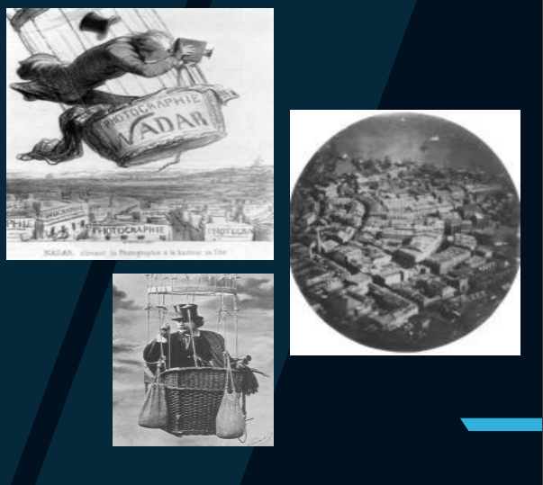
Aerial Photograph 18th Century
1858 - Gasper Felix Tournachon “Nadar" takes the first aerial photograph from a hot air balloon at an altitude of 1,200 feet over Paris.
The photograph was taken using a large-format camera attached to the basket of the balloon.

Slide 11
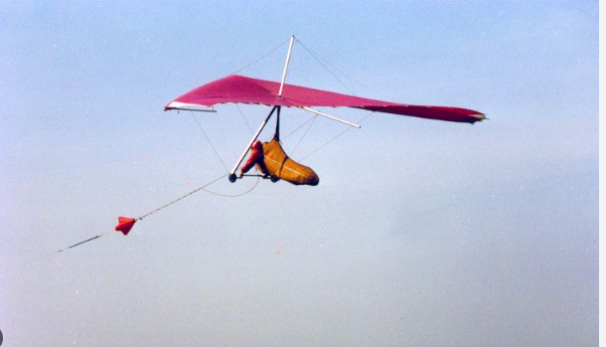
Kites - 1880
KITES were used to obtain aerial Photographs from about 1882. The most famous Kite Photographer was the American G.R. Lawrence.
In 1906, George Lawrence took the Aerial Photographs of San Francisco Earthquake.
Atmospheric Research: Kites have played a role in atmospheric research, particularly in the late 19th and early 20th centuries.
Military applications: Kites were employed for military purposes, particularly during World War I and World War II.

Slide 12
Pigeon cameras
1903: Julius Neubronner invents the pigeon camera, a method of aerial photography using homing pigeons equipped with small cameras.
The small camera was mounted on a lightweight harness that could be worn by the pigeon without hindering its flight.
Once the pigeons returned to their home base, the camera and the exposed plates or film rolls would be retrieved and the images developed.

Slide 13
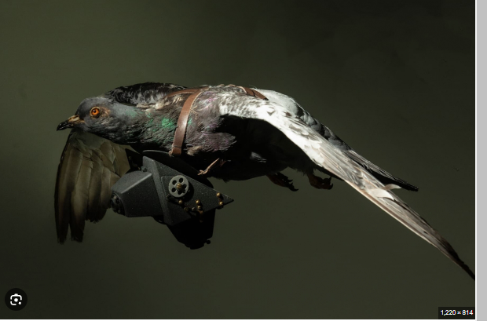
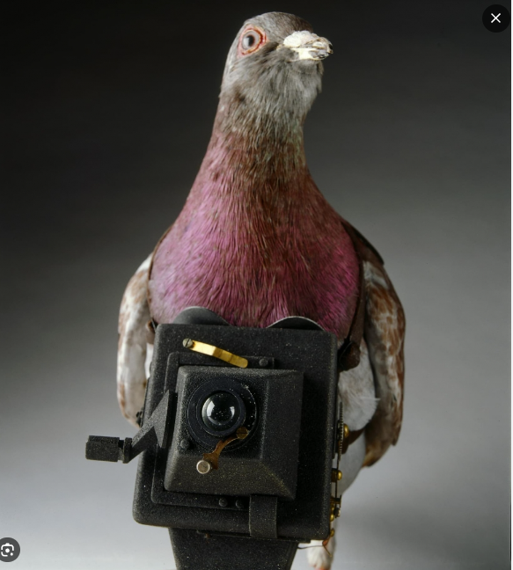
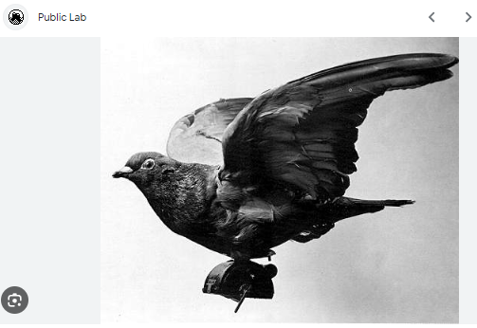

Slide 14
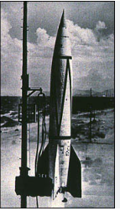
Rockets
In the year 1906, Albert Maul used a Rocket powered by compressed air to lift a camera and took an Aerial Photograph from a height of 2,600 ft;
The Camera was then ejected and parachuted back to the Earth.
The first significant use of rocket-powered cameras was during and after World War II when captured German V-2 rockets were repurposed by various nations for scientific research.

Slide 15
Medieval Age
1908- 1945

Slide 16
Aircrafts
In 1903, Wilbur Wright and Orville Wright(Wright Brothers) of Dayton, Ohio invented the first Flying Machine by building up a 12-hp engine.
The first time that an Airplane was used as a Platform to obtain Aerial Photography was in 1908, when motion picture photographer L.P.Bonvillian accompanied Wilbur Wright. A year later, the first motion picture was recorded in Italy by Wilbur Wright.

Slide 17
Medieval age …continued
Increased Spatial Coverage: Aircraft-based remote sensing allows for larger spatial coverage compared to ground-based methods.
Higher Spatial Resolution: Aircraft platforms provide the capability to capture imagery at high spatial resolutions.
Flexibility and Rapid Response: Aircraft-based remote sensing offers flexibility and rapid response capabilities.
Multi-Sensor Integration: Aircraft platforms provide the ability to integrate multiple sensors and instruments simultaneously.

Slide 18
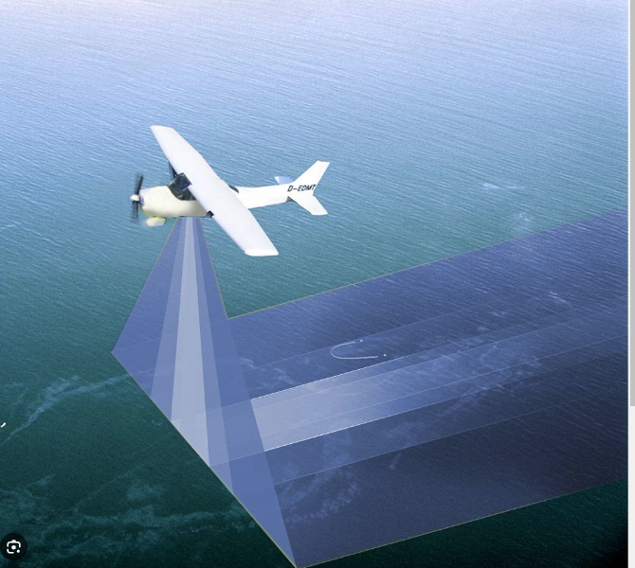
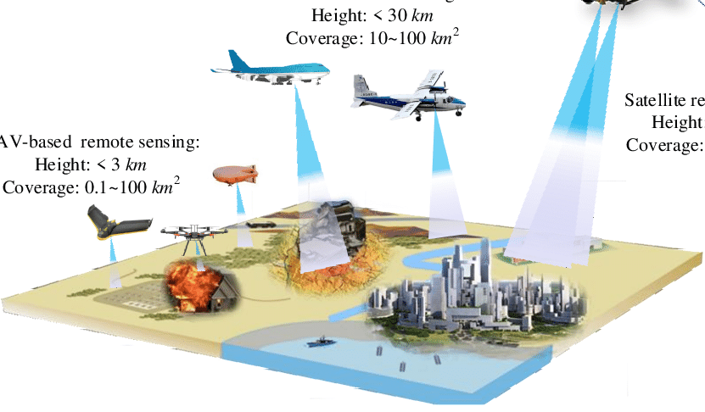

Slide 19
The Modern Age / Space Age
1946 onwards

Slide 20
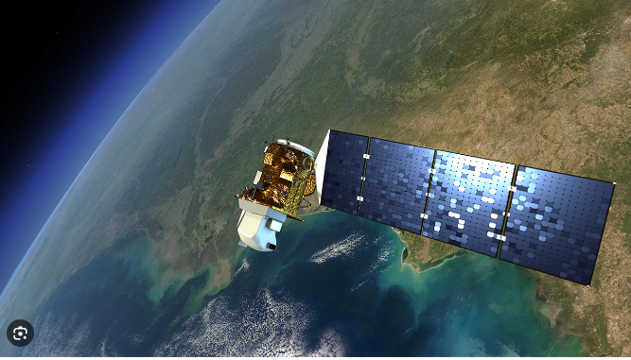
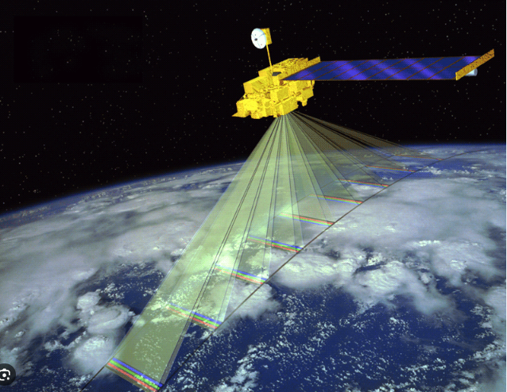
Space Remote Sensing
Space remote sensing began in earnest in the period 1946-50 when many cameras were carried on rockets and ballistic missiles. Remote sensing above the atmosphere originated early in the space age (both Russian and American programs).
The Soviet Union surprised the world when they launched Sputnik , the world's first artificial satellite, on 4 October 1957.
The early earth observation and experimental (weather satellite, the Television and Infrared Observation Satellite (TIROS), was launched on 1 April 1960 by the United States.

Slide 21

National Aeronautics and Space Administration (NASA)
In 1967, the National Aeronautics and Space Administration (NASA) encouraged the US Department of the Interior, initiated the Earth Resource Technology Satellite(ERTS) program.
Landsat-1 was launched on 23 July 1972 carried the multi-spectral scanner (MSS), which imaged the earth from a 900-km altitude with green, red, and two infrared spectral bands at 80 m spatial resolution
It made Satellite Imagery available to the general public for the first time.

Slide 22
SPOT Satellites
France entered the world of satellite remote sensing technology on 21 February 1986 by launching SPOT-1 (Systeme Probatorie de la Observation de la Terre).
India successfully operates several remote sensing satellites that gather data in different bands of electromagnetic spectrum, beginning with the launch of IRS1A in March 1988.

Slide 23
Commercial Satellites
Since the early 1960s, of the approximately 2,700 satellites (up to 2011) in the orbit-with many active (now operating), most are/were either military in origin, or flown as a general service by the United States, France, Russia, India, Japan, and other governments.
Remote sensing and meteorological satellites were or are mainly sponsored and controlled by government agencies. WHY.
Space Imaging Inc. (now GeoEye Inc.) launched IKONOS on 27 April 1999 and it failed to achieve orbit. A second IKONOS satellite was launched on 24 September 1999; the first successful remote sensing satellite launched by a private organization.

Slide 24
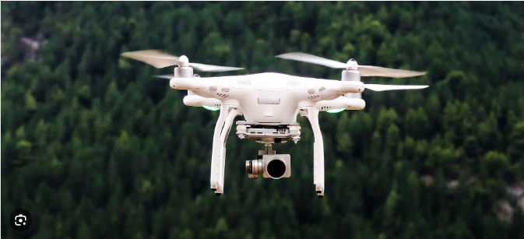
Unmanned Aerial Vehicles (Drones)
Small scale remote sensing applications – Precision agriculture. Fine scale remote sensing
Improved Maneuverability and Stability: UAVs have benefited from advances in flight control systems and stabilization technologies, allowing them to capture more stable and precise imagery.
Autonomous and Semi-Autonomous Capabilities: The development of autonomous and semi-autonomous flight systems has enabled UAVs to perform pre-programmed missions or follow waypoints, reducing the need for constant manual control.

Slide 25
Discussion
Which period recorded major breakthrough in the development of remote sensing technology.
With reference to specific examples describe the applications of remote sensing in your field.

